Slide 1
Online Course Registration Portal CST499 Final Project Instructor: Joseph Rangitsch
By Joshua Murray 6/16/2025

Slide 2
Objectives & Key Features
Describe the Online Portal
Account Creation
Login/Logout
View Available Courses
Add/Drop Courses

Slide 3
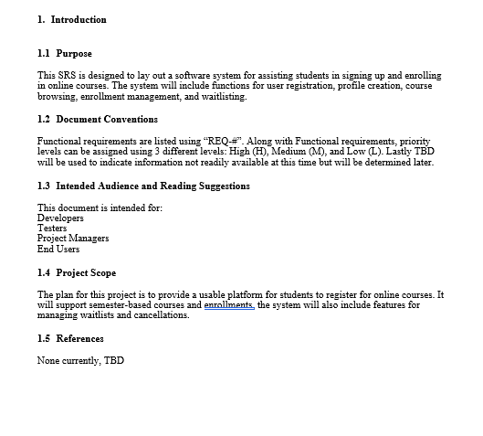
Software Requirements Specification

Slide 4
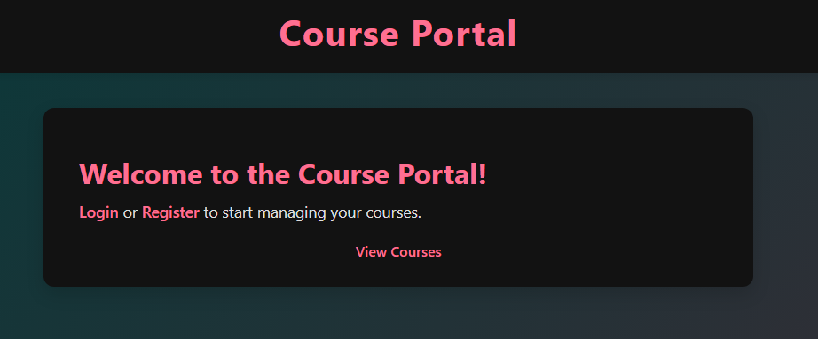

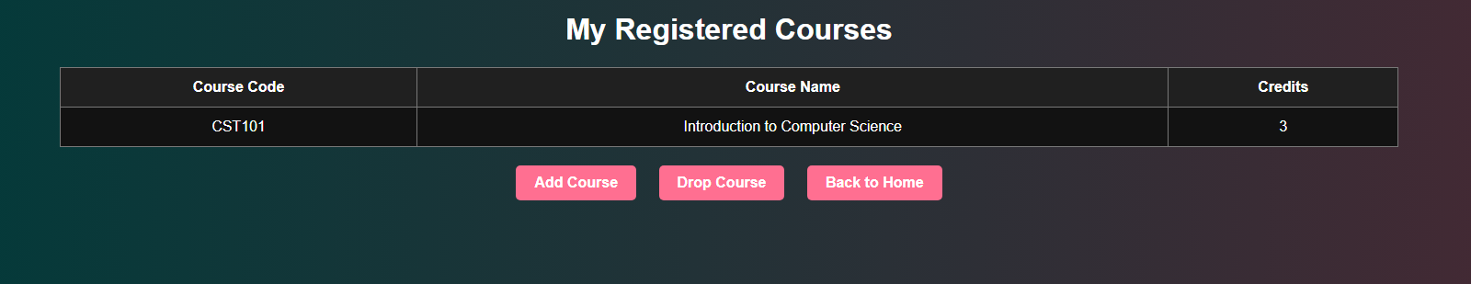
Key Functional Requirements

Slide 5
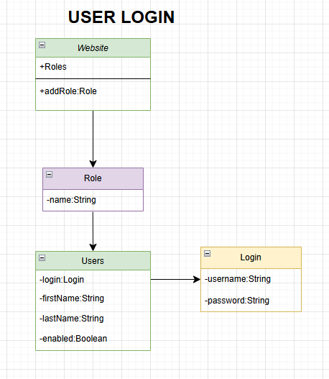
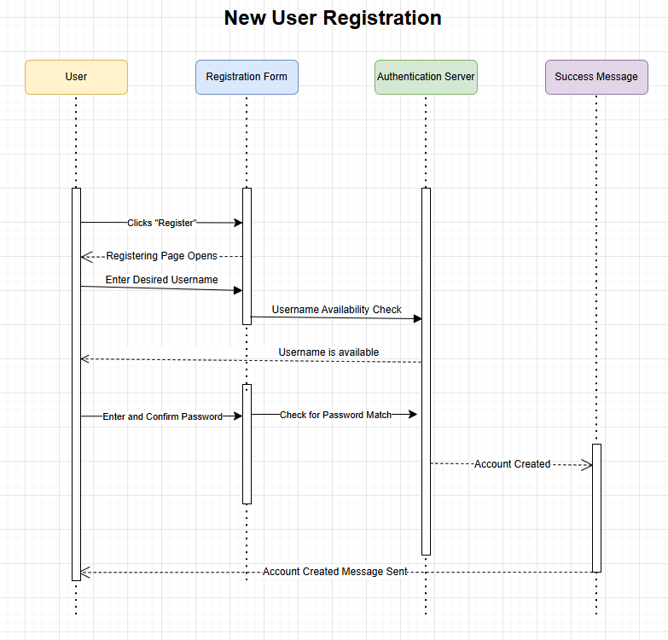
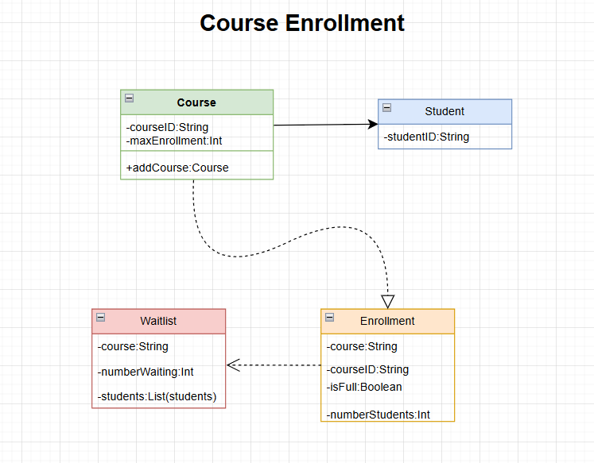
UML Design Model

Slide 6
Landing Page

Slide 7
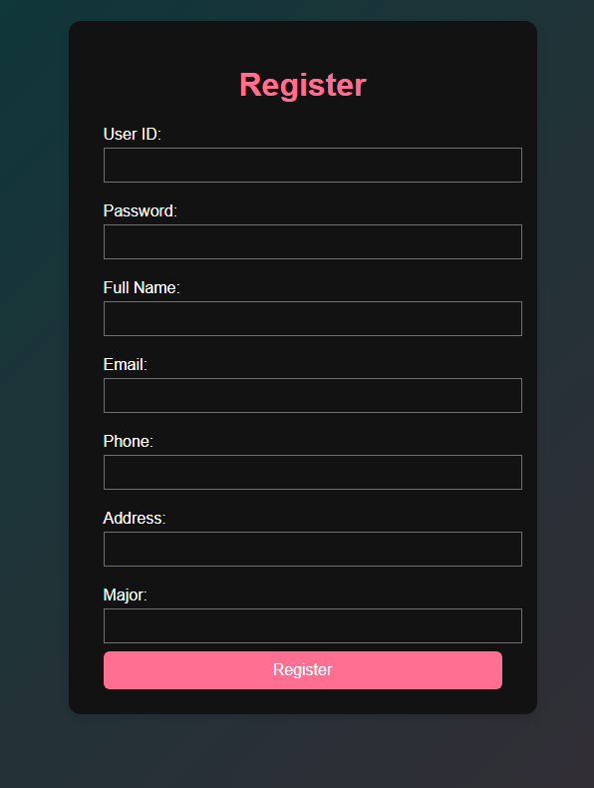
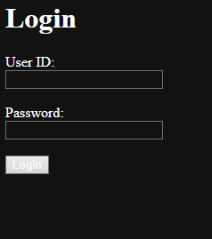
Registration and Login Page

Slide 8
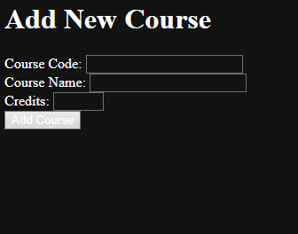
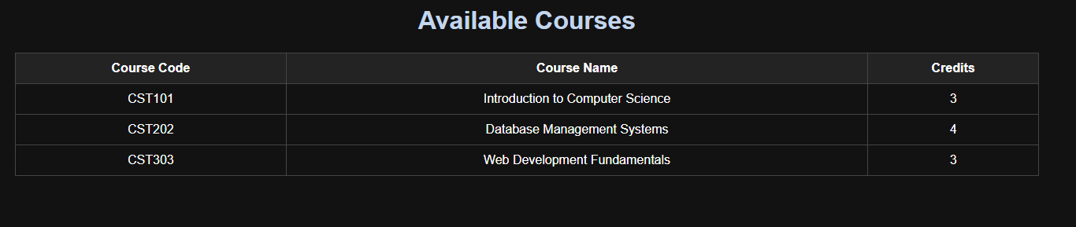
Course Enrollment Page

Slide 9

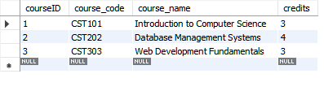


MySQL Database Tables

Slide 10
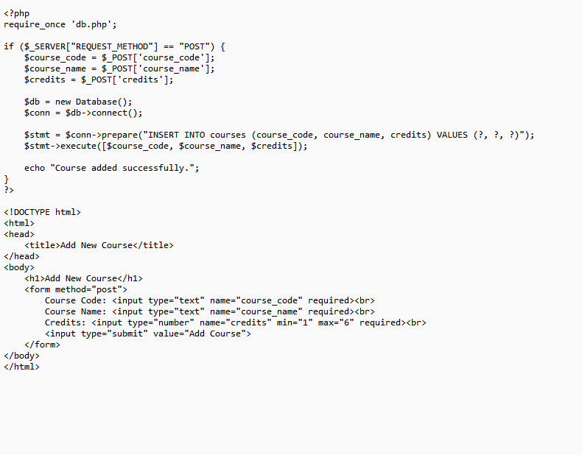
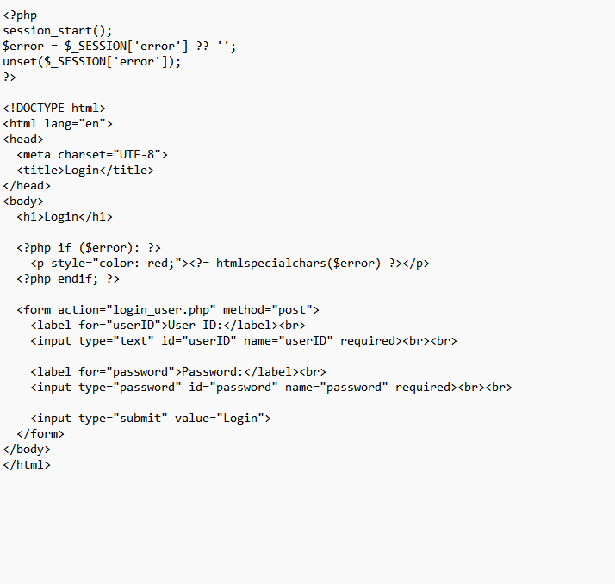
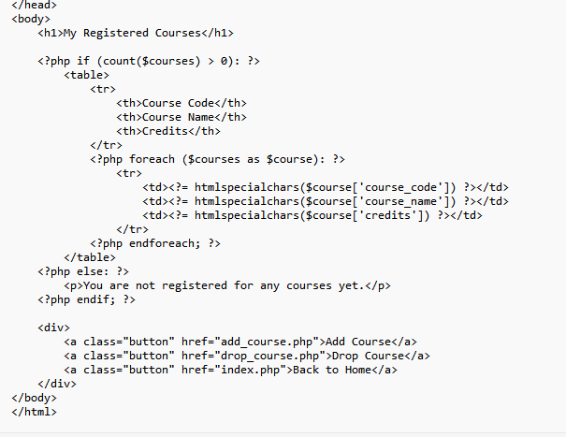
PHP Code and Application Logic
Add Course
Login
View Courses

Slide 11
Conclusion and Reflections
Review Objectives and Key Functions
Self-reflection
Lessons Learned
Possible improvements for next time

